Slide 1


Python: Object-Oriented programming

Slide 2
Agenda
Object oriented programming language
Basic modules
Error and exception handling
Basic packages

Slide 3
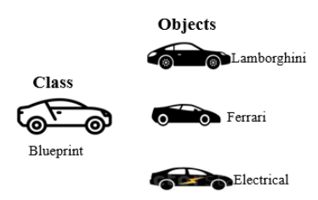
Python OOPs Concepts
Like other general-purpose programming languages, Python is also an object-oriented language since its beginning. It allows us to develop applications using an Object-Oriented approach.
An object-oriented paradigm is to design the program using classes and objects. The object is related to real-word entities such as book, house, pencil, etc. The oops concept focuses on writing the reusable code. It is a widespread technique to solve the problem by creating objects.
Major principles of object-oriented programming system are given below.
Class
Object
Method
Inheritance
Polymorphism
Data Abstraction
Encapsulation

Slide 4
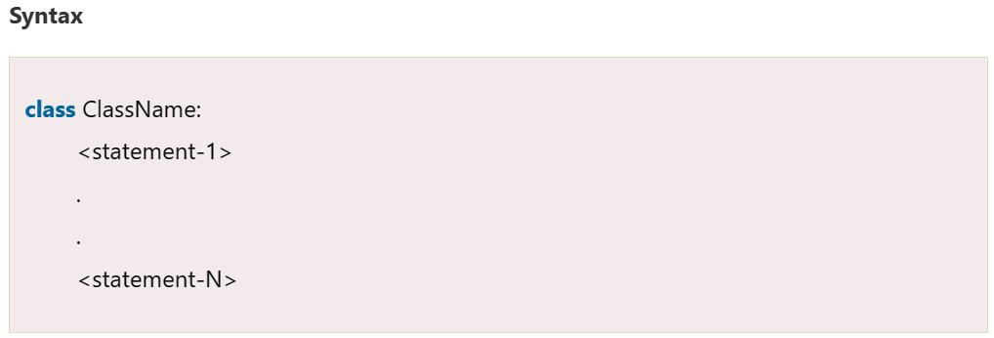
I. Class
The class can be defined as a collection of objects. It is a logical entity that has some specific attributes and methods.
For example: if you have an employee class, then it should contain an attribute and method, i.e. an email id, name, age, salary, etc.

Slide 5
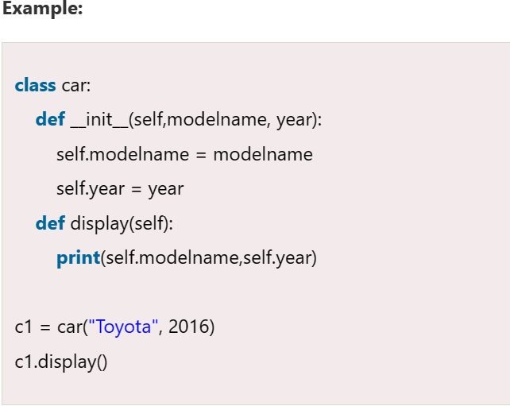
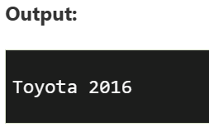
II. Object
The object is an entity that has state and behavior. It may be any real-world object like the mouse, keyboard, chair, table, pen, etc.
Everything in Python is an object, and almost everything has attributes and methods. All functions have a built-in attribute __doc__, which returns the docstring defined in the function source code.
When we define a class, it needs to create an object to allocate the memory.

Slide 6
III. Method
The method is a function that is associated with an object. In Python, a method is not unique to class instances. Any object type can have methods.

Slide 7
IV. Inheritance
Inheritance is regarded as the most significant characteristics of OOP. A class's ability to inherit methods and/or characteristics from another class is known as inheritance.
Inheritance is the most important aspect of object-oriented programming, which simulates the real-world concept of inheritance. It specifies that the child object acquires all the properties and behaviors of the parent object.
By using inheritance, we can create a class which uses all the properties and behavior of another class. The new class is known as a derived class or child class, and the one whose properties are acquired is known as a base class or parent class.

Slide 8
V. Polymorphism
Polymorphism contains two words "poly" and "morphs". Poly means many, and morph means shape. By polymorphism, we understand that one task can be performed in different ways.
For example - you have a class animal, and all animals speak. But they speak differently. Here, the "speak" behavior is polymorphic in a sense and depends on the animal. So, the abstract "animal" concept does not actually "speak", but specific animals (like dogs and cats) have a concrete implementation of the action "speak".
Polymorphism refers to a subclass's ability to adapt a method that already exists in its superclass to meet its needs. To put it another way, a subclass can use a method from its superclass as is or modify it as needed.

Slide 9
VI. Encapsulation
Encapsulation is also an essential aspect of object-oriented programming.
It is used to restrict access to methods and variables. In encapsulation, code and data are wrapped together within a single unit from being modified by accident.

Slide 10
VII. Data Abstraction
Data abstraction and encapsulation both are often used as synonyms. Both are nearly synonyms because data abstraction is achieved through encapsulation.
Abstraction is used to hide internal details and show only functionalities. Abstracting something means to give names to things so that the name captures the core of what a function or a whole program does.

Slide 11
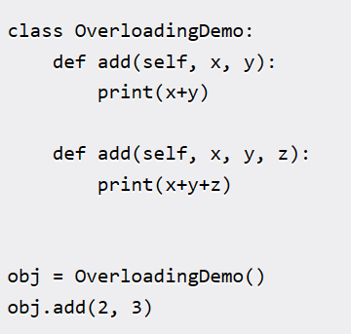
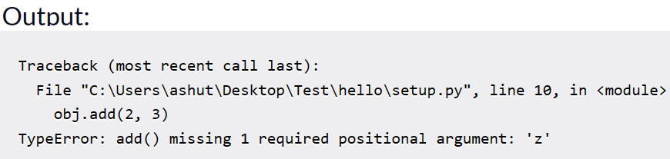
VIII. Method Overloading
The concept of method overloading is found in almost every well-known programming language that follows object-oriented programming concepts. It simply refers to the use of many methods with the same name that take various numbers of arguments within a single class.
Python doesn't support Method Overloading by default.

Slide 12
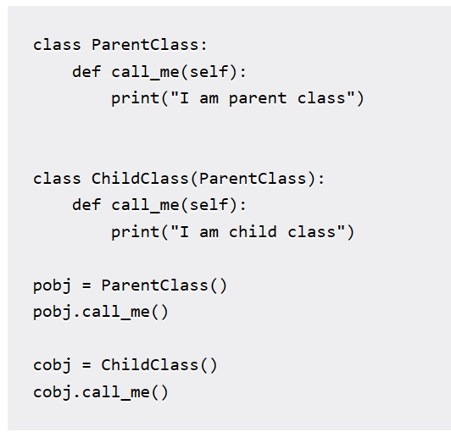
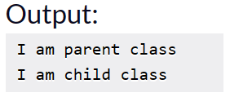
Method Overriding
When a method with the same name and arguments is used in both a derived class and a base or super class, we say that the derived class method "overrides" the method provided in the base class.
When the overridden method gets called, the derived class's method is always invoked. The method that was used in the base class is now hidden.

Slide 13
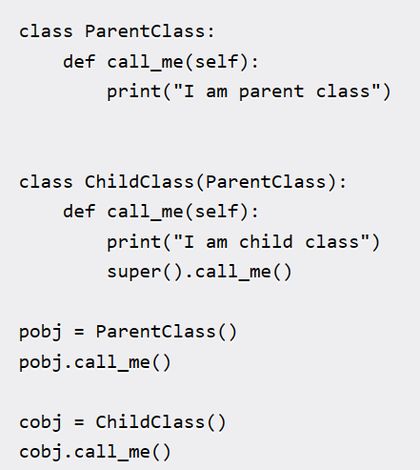
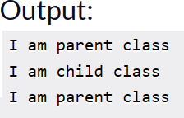
Method Overriding
When the call_me() method was called on the child object, the call_me() from the child class was invoked. We can invoke the parent class's call_me() method from the child class using super().

Slide 14
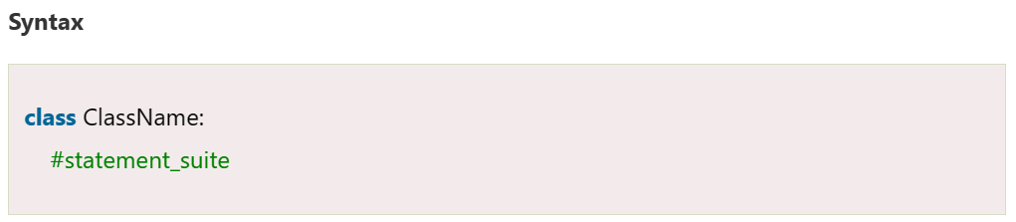
Classes and Objects in Python
A class is a virtual entity and can be seen as a blueprint of an object. The class came into existence when it instantiated.
Suppose a class is a prototype of a building. A building contains all the details about the floor, rooms, doors, windows, etc. we can make as many buildings as we want, based on these details. Hence, the building can be seen as a class, and we can create as many objects of this class.
On the other hand, the object is the instance of a class. The process of creating an object can be called instantiation.
Creating Classes in Python : In Python, a class can be created by using the keyword class, followed by the class name.

Slide 15
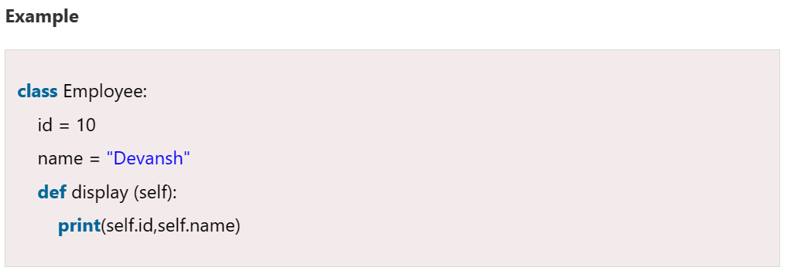
Creating Classes in Python
In Python, we must notice that each class is associated with a documentation string which can be accessed by using <class-name>.__doc__. A class contains a statement suite including fields, constructor, function, etc.
Here, the self is used as a reference variable, which refers to the current class object. It is always the first argument in the function definition. However, using self is optional in the function call.

Slide 16
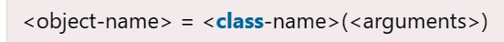
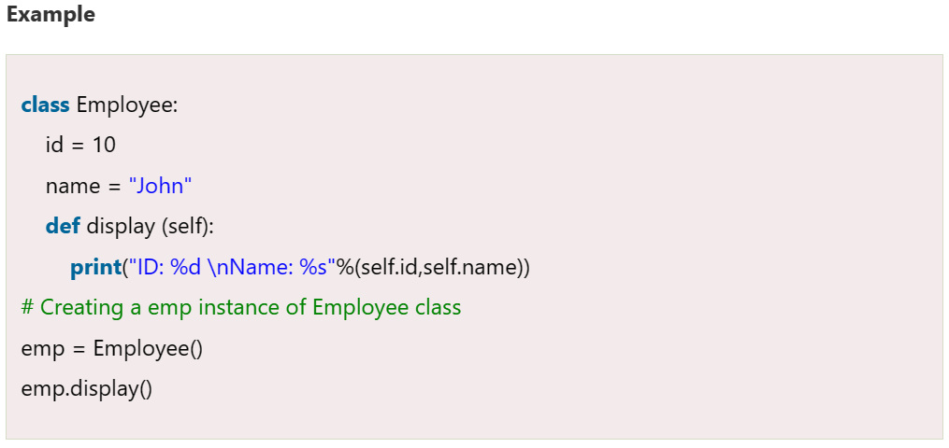
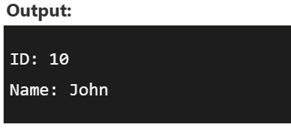
Creating Objects (instance) in Python
A class needs to be instantiated if we want to use the class attributes in another class or method. A class can be instantiated by calling the class using the class name.
The syntax to create the instance of the class is given below.

Slide 17
Python Constructor
A constructor is a special type of method (function) which is used to initialize the instance members of the class.
Constructors can be of two types.
Parameterized Constructor
Non-parameterized Constructor
Constructor definition is executed when we create the object of this class. Constructors also verify that there are enough resources for the object to perform any start-up task.

Slide 18
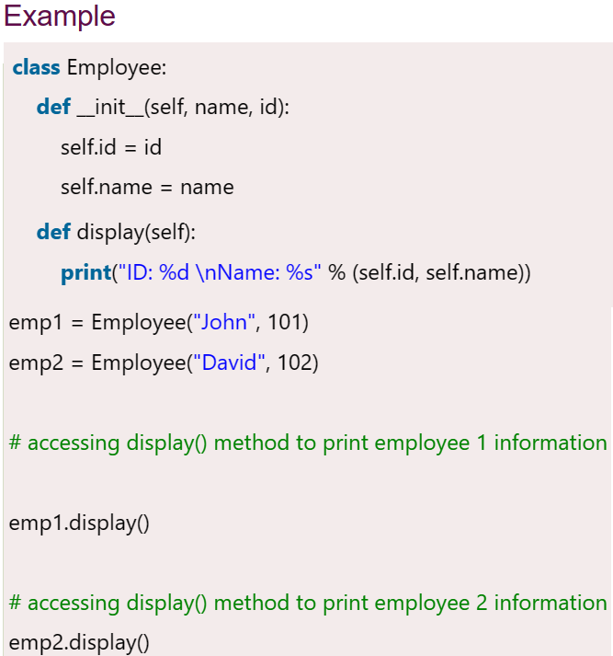
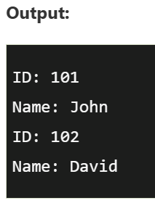
Creating the constructor in python
In Python, the method the __init__() simulates the constructor of the class. This method is called when the class is instantiated. It accepts the self-keyword as a first argument which allows accessing the attributes or method of the class.
We can pass any number of arguments at the time of creating the class object, depending upon the __init__() definition. It is mostly used to initialize the class attributes. Every class must have a constructor, even if it simply relies on the default constructor.

Slide 19
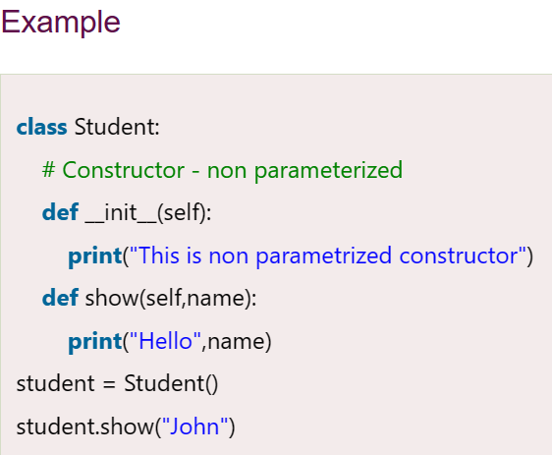
Python Non-Parameterized Constructor
The non-parameterized constructor uses when we do not want to manipulate the value or the constructor that has only self as an argument.

Slide 20
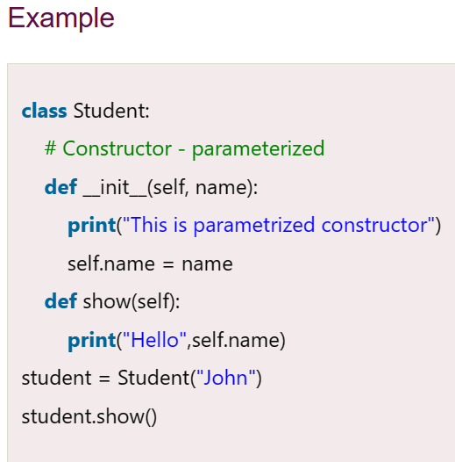
Python Parameterized Constructor
The parameterized constructor has multiple parameters along with the self.

Slide 21
Python built-in class functions
SN | Function | Description
1 | getattr(obj,name,default) | It is used to access the attribute of the object.
2 | setattr(obj, name,value) | It is used to set a particular value to the specific attribute of an object.
3 | delattr(obj, name) | It is used to delete a specific attribute.
4 | hasattr(obj, name) | It returns true if the object contains some specific attribute.

Slide 22
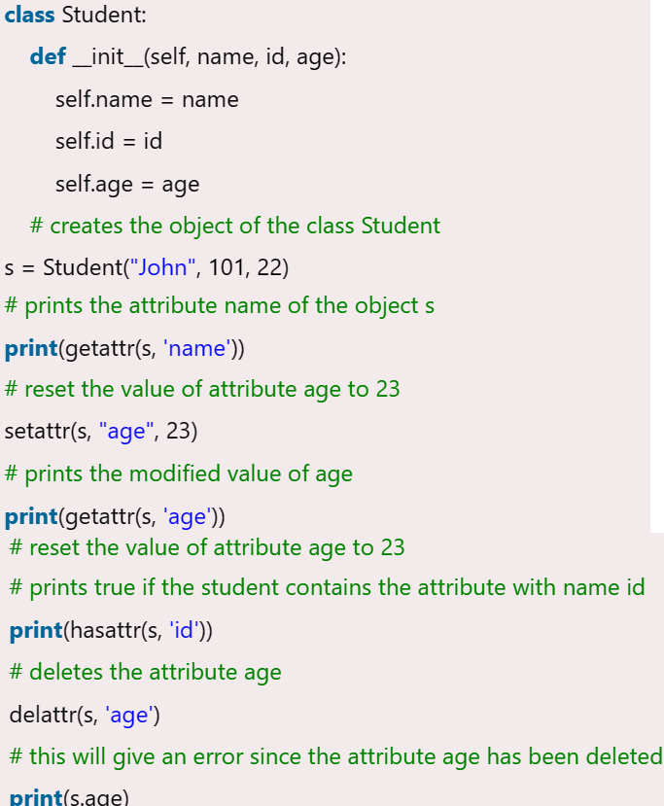
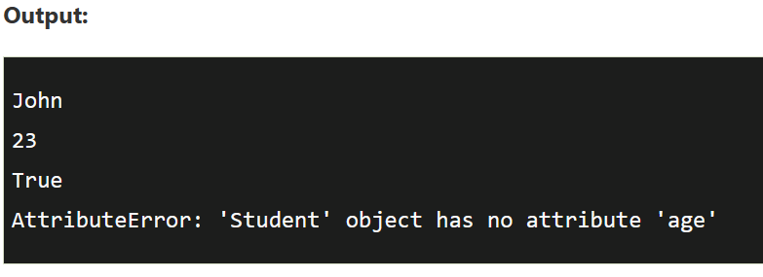
Example of built-in class functions

Slide 23
Built-in class attributes
Along with the other attributes, a Python class also contains some built-in class attributes which provide information about the class.
SN | Attribute | Description
1 | __dict__ | It provides the dictionary containing the information about the class namespace.
2 | __doc__ | It contains a string which has the class documentation
3 | __name__ | It is used to access the class name.
4 | __module__ | It is used to access the module in which, this class is defined.
5 | __bases__ | It contains a tuple including all base classes.

Slide 24
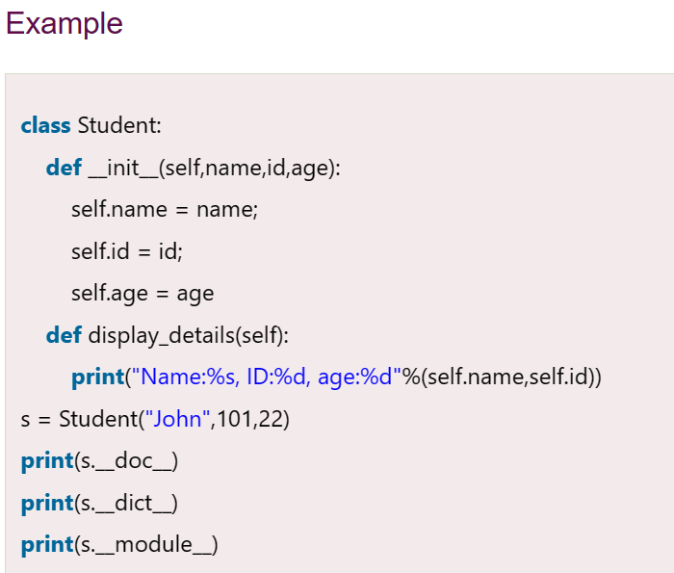
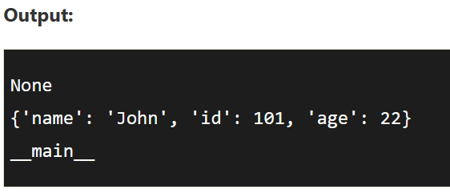
Example of Built-in class attributes

Slide 25
Python Modules
In Python, Modules are simply files with the “.py” extension containing Python code that can be imported inside another Python Program.
In simple terms, we can consider a module to be the same as a code library or a file that contains a set of functions that you want to include in your application.
The module contains the following components:
Definitions and implementation of classes,
Variables, and
Functions that can be used inside another program.

Slide 26
Create a simple Python module
Let’s create a simple calc.py in which we define two functions, one add and another subtract.
# A simple module, calc.py
# Save this code to a file # with name calc.py
def add(x, y):
return (x+y)
def subtract(x, y):
return (x-y)

Slide 27
Import Module in Python
We can import the functions, and classes defined in a module to another module using the import statement in some other Python source file.
When the interpreter encounters an import statement, it imports the module if the module is present in the search path.
A search path is a list of directories that the interpreter searches for importing a module.
For example, to import the module calc.py, we need to put the following command at the top of the script.
# importing module calc.py
import calc
print(calc.add(10, 2))

Slide 28
Errors and Exceptions in Python
Errors are the problems in a program due to which the program will stop the execution. On the other hand, exceptions are raised when some internal events occur which changes the normal flow of the program.
Two types of Error occurs in python.
Syntax errors
Logical errors (Exceptions)

Slide 29
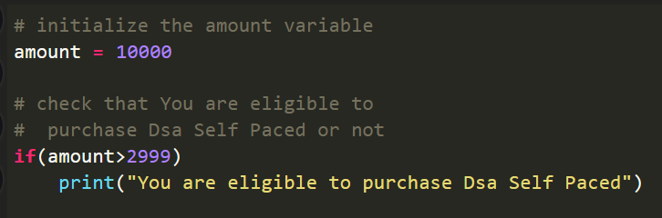

Syntax errors
When the proper syntax of the language is not followed then a syntax error is thrown.
Example:
Output
It returns a syntax error message because after the if statement a colon: is missing. We can fix this by writing the correct syntax.

Slide 30
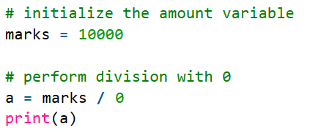

Logical errors(Exception)
When in the runtime an error that occurs after passing the syntax test is called exception or logical type.
For example, when we divide any number by zero then the ZeroDivisionError exception is raised, or when we import a module that does not exist then ImportError is raised.
Example:
Output

Slide 31
Exceptions in Python
Exception | Description
IndexError | When the wrong index of a list is retrieved.
AssertionError | It occurs when the assert statement fails
AttributeError | It occurs when an attribute assignment is failed.
ImportError | It occurs when an imported module is not found.
KeyError | It occurs when the key of the dictionary is not found.
NameError | It occurs when the variable is not defined.
MemoryError | It occurs when a program runs out of memory.
TypeError | It occurs when a function and operation are applied in an incorrect type.

Slide 32
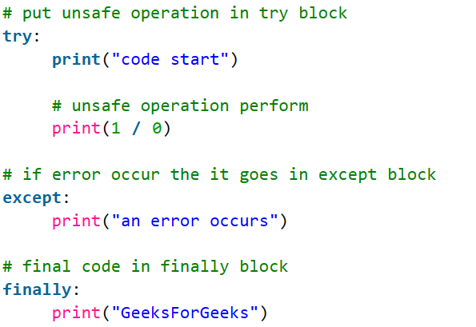
Error Handling
When an error and an exception are raised then we handle that with the help of the Handling method.
Handling Exceptions with Try/Except/Finally
We can handle errors by the Try/Except/Finally method. we write unsafe code in the try, fall back code in except and final code in finally block.

Slide 33
Python – Basic packages
There are some basic packages in python that can be directly imported and can be used.
Some of the basic packages are:
OS
Datetime
csv
Random
Sys
Math

Slide 34
OS package
Python OS module provides the facility to establish the interaction between the user and the operating system. It offers many useful OS functions that are used to perform OS-based tasks and get related information about operating system.
Some functions of OS package:
os.name() – provides the the name of the operating system module that it imports.
os.mkdir() -- The os.mkdir() function is used to create new directory.
os.getcwd() -- It returns the current working directory(CWD) of the file.
os.chdir() -- The os module provides the chdir() function to change the current working directory.
os.rmdir() -- The rmdir() function removes the specified directory with an absolute or related path. First, we have to change the current working directory and remove the folder.
os.popen() -- This function opens a file or from the command specified, and it returns a file object which is connected to a pipe.
Os.close() – Close the open file.

Slide 35
Examples of OS package
import os
fd = "python.txt"
# popen() is similar to open()
file = open(fd, 'w')
file.write("This is awesome")
file.close()
file = open(fd, 'r')
text = file.read()
print(text)
# popen() provides gateway and accesses the file directly
file = os.popen(fd, 'w')
file.write("This is awesome")
# File not closed, shown in next function.
import os
fr = "Python1.txt"
file = open(fr, 'r')
text = file.read()
print(text)
os.close(file)

Slide 36
The datetime package
In Python, date and time are not a data type of their own, but a module named datetime can be imported to work with the date as well as time. Python Datetime module comes built into Python, so there is no need to install it externally.
The DateTime module is categorized into 6 main classes –
date – An idealized naive date, assuming the current Gregorian calendar always was, and always will be, in effect. Its attributes are year, month and day.
time – An idealized time, independent of any particular day, assuming that every day has exactly 24*60*60 seconds. Its attributes are hour, minute, second, microsecond, and tzinfo.
datetime – Its a combination of date and time along with the attributes year, month, day, hour, minute, second, microsecond, and tzinfo.
timedelta – A duration expressing the difference between two date, time, or datetime instances to microsecond resolution.
tzinfo – It provides time zone information objects.
timezone – A class that implements the tzinfo abstract base class as a fixed offset from the UTC (New in version 3.2).

Slide 37
Example of datetime package
# Python program to
# print current date
from datetime import date
# calling the today
# function of date class
today = date.today()
print("Today's date is", today)
from datetime import date
# date object of today's date
today = date.today()
print("Current year:", today.year)
print("Current month:", today.month)
print("Current day:", today.day)

Slide 38
Python Math Module
Sometimes when working with some kind of financial or scientific projects it becomes necessary to implement mathematical calculations in the project. Python provides the math module to deal with such calculations. Math module provides functions to deal with both basic operations such as addition(+), subtraction(-), multiplication(*), division(/) and advance operations like trigonometric, logarithmic, exponential functions.
There a large number of math methods here we have listed some of them.
Method | Description
math.acos() | Returns the arc cosine of a number
math.acosh() | Returns the inverse hyperbolic cosine of a number
math.asin() | Returns the arc sine of a number
math.asinh() | Returns the inverse hyperbolic sine of a number
math.atan() | Returns the arc tangent of a number in radians
math.atan2() | Returns the arc tangent of y/x in radians
math.atanh() | Returns the inverse hyperbolic tangent of a number

Slide 39
Math methods
math.cos() | Returns the cosine of a number
math.cosh() | Returns the hyperbolic cosine of a number
math.degrees() | Converts an angle from radians to degrees
math.dist() | Returns the Euclidean distance between two points (p and q), where p and q are the coordinates of that point
math.erf() | Returns the error function of a number
math.erfc() | Returns the complementary error function of a number
math.exp() | Returns E raised to the power of x
math.expm1() | Returns E^{x} - 1
math.fabs() | Returns the absolute value of a number
math.factorial() | Returns the factorial of a number
math.floor() | Rounds a number down to the nearest integer
math.fmod() | Returns the remainder of x/y

Slide 40
Math constants
Constant | Description
math.e | Returns Euler's number (2.7182...)
math.inf | Returns a floating-point positive infinity
math.nan | Returns a floating-point NaN (Not a Number) value
math.pi | Returns PI (3.1415...)
math.tau | Returns tau (6.2831...)

Slide 41
Example of Math module
# Program to print +ve infinity and –ve infinity
# Import math Library
import math
# Print the positive infinity
print (math.inf)
# Print the negative infinity
print (-math.inf)
# Import math Library
import math
# Print the value of nan
print (math.nan)
# Python code to demonstrate the working of
# ceil() and floor()
# importing "math" for mathematical operations
import math
a = 2.3 # returning the ceil of 2.3
print ("The ceil of 2.3 is : ", end="")
print (math.ceil(a))
# returning the floor of 2.3
print ("The floor of 2.3 is : ", end="")
print (math.floor(a))

Slide 42
Example of Math package
# Python code to demonstrate the working of
# factorial()
# importing "math" for mathematical operations
import math
a = 5
# returning the factorial of 5
print("The factorial of 5 is : ", end="")
print(math.factorial(a))
# Python code to demonstrate the working of
# gcd()
# importing "math" for mathematical operations
import math
a = 15
b = 5
# returning the gcd of 15 and 5
print ("The gcd of 5 and 15 is : ", end="")
print (math.gcd(b, a))

Slide 43
The random package
Python Random module is an in-built module of Python which is used to generate random numbers. These are pseudo-random numbers means these are not truly random. This module can be used to perform random actions such as generating random numbers, print random a value for a list or string, etc.
Some methods of random module
Method | Description
seed() | Initialize the random number generator
getstate() | Returns the current internal state of the random number generator
setstate() | Restores the internal state of the random number generator
getrandbits() | Returns a number representing the random bits
randrange() | Returns a random number between the given range
randint() | Returns a random number between the given range
choice() | Returns a random element from the given sequence

Slide 44
Methods of random package
choices() | Returns a list with a random selection from the given sequence
shuffle() | Takes a sequence and returns the sequence in a random order
sample() | Returns a given sample of a sequence
random() | Returns a random float number between 0 and 1
uniform() | Returns a random float number between two given parameters
triangular() | Returns a random float number between two given parameters, you can also set a mode parameter to specify the midpoint between the two other parameters
betavariate() | Returns a random float number between 0 and 1 based on the Beta distribution (used in statistics)
expovariate() | Returns a random float number based on the Exponential distribution (used in statistics)
gammavariate() | Returns a random float number based on the Gamma distribution (used in statistics)

Slide 45
Examples of random package
# import random
import random
# prints a random value from the list
list1 = [1, 2, 3, 4, 5, 6]
print(random.choice(list1))
# Python3 program explaining work
# of randint() function
# import random module
import random
# Generates a random number between
# a given positive range
r1 = random.randint(5, 15)
print("Random number between 5 and 15 is % s" % (r1))
# Generates a random number between
# two given negative range
r2 = random.randint(-10, -2)
print("Random number between -10 and -2 is % d" % (r2))
import random
random.seed(5)
print(random.random())
print(random.random())

Slide 46
Example of random package
# Selecting random elements from the list,
string, and tuple
# Python3 program to demonstrate the use of
# choice() method
# import random
import random
# prints a random value from the list
list1 = [1, 2, 3, 4, 5, 6]
print(random.choice(list1))
# prints a random item from the string
string = "geeks"
print(random.choice(string))
# prints a random item from the tuple
tuple1 = (1, 2, 3, 4, 5)
print(random.choice(tuple1))
# Shuffling a List
# import the random module
import random
# declare a list
sample_list = [1, 2, 3, 4, 5]
print("Original list : ")
print(sample_list)
# first shuffle
random.shuffle(sample_list)
print("\nAfter the first shuffle : ")
print(sample_list)
# second shuffle
random.shuffle(sample_list)
print("\nAfter the second shuffle : ")
print(sample_list)

Slide 47
Thank You

